Slide 1
How to Model Reinsurance in RMS
TIGERRISK PARTNERS

Slide 2
Goals
The goal for this training is to teach new analysts how to create a reinsurance program in RMS to be applied in modelling
Analysts should be able to complete the following after this training;
Create a reinsurance program in RMS
Create XPR, Quota Share, Surplus Share, and Catastrophe reinsurance treaties
Understand how the background tables work in regards to Facultative and Surplus Share reinsurance

Slide 3

00.
TIGERRISK PARTNERS Creating a Reinsurance Treaty

Slide 4
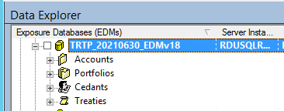
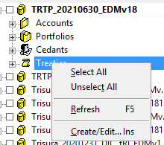
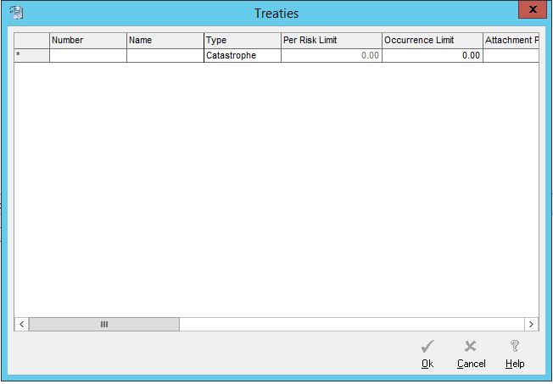
Creating a Reinsurance Treaty
00.
In your EDM, navigate to the Treaties section.
Create a new Treaty
To do this, right click on Treaties -> Create/Edit.
Name it something easily recognizable so you can differentiate if needed
1
3
2

Slide 5
Creating a Reinsurance Treaty (continued)
00.
The following fields are available in the Treaties creation window. And they will apply to some or all the treaty types.
Number: This is a unique identifier for the treaty. Use something that easily describes the layer.
Name: The name of the treaty. Can be the same as the number.
Type
Catastrophe – RMS views these as treaties that apply to a single line of business or subdivision.
Corporate – RMS views these as treaties that apply to an enterprise that comprise multiple business units. These apply to the loss net of all Catastrophe treaties.
Stop Loss – These are to protect a company in the case of multiple losses. The attachment points and limits are on an aggregate basis. These apply to losses net of all Catastrophe and Corporate treaties.
Quota Share – RMS views these as treaties that apply uniformly across Locations/Policies/Accounts that have a proportional share of loss. (but seems to be functionally equivalent to Working Excess)
Working Excess – these are treaties that apply uniformly across Locations/Policies/Accounts that have excess loss on a per risk basis.
Surplus Share – these are treaties that have custom terms specific to each Location/Policy for which they apply. In order to use Surplus Share treaties in RMS you will need to import Reinsurance terms with the exposure on import with SS information. Then in the UI you will need to create the per event SS terms. Note that the SS name in the Treaty creation must match the REINSID used on import.

Slide 6
Creating a Reinsurance Treaty (continued)
00.
The following fields are available in the Treaties creation window. And they will apply to some or all the treaty types.
Per Risk Limit – Used only for Quota Share or Working Excess Treaties. This is used to limit the amount of loss that can come from a single Location/Policy/Account. If there is no per risk limit (unlimited), enter 0.
Occ. Limit – Defines the maximum loss payable under the treaty due to any one event.
Att. Point – This is where the treaty takes effect.
Lines of Business – These are the LOBs that the treaty will apply to. For Catastrophe, Corp. Cat and Stop Loss this will always be all LOBs. For Surplus Share, Quota Share and Working Excess you can select the LOBs that should apply.
Cedant – The cedant ID for the cedant to whom you want to assign the treaty. This must match a Cedant ID in the EDM.
% Covered – Defines the percentage of loss greater than the Attachment Point covered by the treaty.
% Placed – Defines the total percentage of the treaty’s coverage that has been accepted by participating reinsurers.
% Share – Defines the percentage of the placed treaty coverage that is assigned to the reinsurer. This percentage is used to determine the losses for the Reinsurance Gross Loss financial perspective.
% Retention – Defines the percentage of the reinsurer’s share of the treaty losses that are not covered by retro.

Slide 7
Creating a Reinsurance Treaty (continued)
00.
The following fields are available in the Treaties creation window. And they will apply to some or all the treaty types.
Premium – The total premium paid by the ceding company.
# of Reinstmts – This is only available for Catastrophe treaties.
% Reinstmt Chg – The reinstatement charge for a single reinstatement, as a percentage of total premium.
Inuring Priority – This sets the order in which reinsurance applies. Subsequent numbers take subsequent losses. A treaty with inuring priority 1 inures to the benefit of a treaty with an inuring priority greater than 1.
Producer – Ties out to the EDM. (Not required)
Inception Date – The date on which the treaty takes effect. To make sure that the treaty applies you can set this to several years before current.
Expiration Date – The last date on which the treaty is in effect. To make sure that the treaty applies you can set this to several years after current.
Currency – Currency that the treaty is modeled in.
Attachment Basis – stating how to determine if events should apply.
Losses Occurring – For the treaty to apply, the analysis event date must fall within the treaty dates.
Risks Attaching – For the treaty to apply, each policy’s inception date should fall within the treaty dates.
Exposure Level – The exposure level to which the treaty applies.

Slide 8
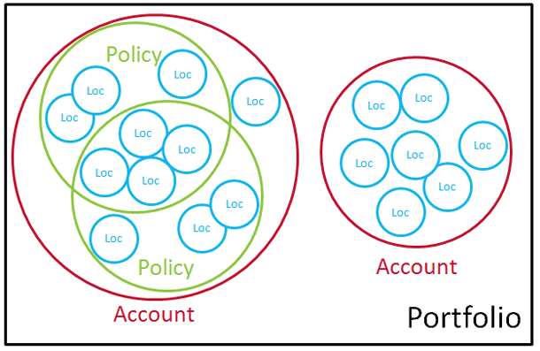
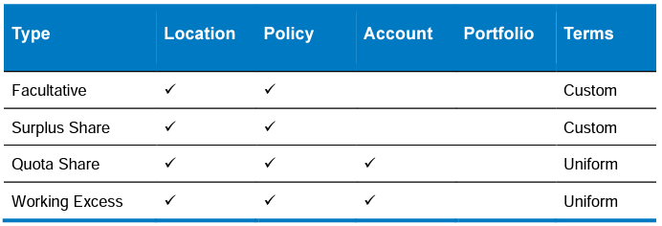
Visualizing Levels of Risk
00.

Slide 9
01.
TIGERRISK PARTNERS Facultative Reinsurance

Slide 10
Facultative Reinsurance
01.
Facultative Reinsurance is Reinsurance that is purchased by an insurer for a single risk or a defined package of risks that is individually underwritten by the reinsurer.
Unlike the other types of reinsurance, facultative (FAC) reinsurance is modeled completely in the background of the model
A file is imported along with the Account and Location file which contains links to the exposure data and details what reinsurance covers the individual risks
FAC can cover risks at either the location or policy level and will have an attachment point, limit and participation amount
FAC detail is stored in the reinsinf table in your EDM database
Once the data is imported it will automatically be applied in your modelling

Slide 11
Sample Import File
01.
REINSTYPE | FACNAME | REINSID | EXPOSRTYPE | EXPOSRNUM | PCNTREINS | LAYERAMT | LAYERCUR | EXCESSAMT | EXCESSCUR
F | 2543 | 2543 | LOC | 784666 | 1 | 15,000,000 | USD | 20,000,000 | USD
F | 2544 | 2544 | LOC | 784666 | 1 | 15,000,000 | USD | 35,000,000 | USD
F | 2555 | 2555 | LOC | 814728 | 1 | 2,500,000 | USD | 27,000,000 | USD
F | 2702 | 2702 | LOC | 830778 | 1 | 9,619,961 | USD | 50,000,000 | USD
F | 2547 | 2547 | LOC | 784820 | 1 | 3,551,092 | USD | 20,000,000 | USD
F | 2206 | 2206 | POL | 19796 | 1 | 78,739,000 | USD | 50,000,000 | USD
F | 2213 | 2213 | POL | 19860 | 1 | 32,273,000 | USD | 50,000,000 | USD
F | 2530 | 2530 | POL | 22565 | 1 | - | USD | 67,467,737 | USD
F | 2696 | 2696 | POL | 51019 | 1 | 35,000,000 | USD | 49,990,000 | USD
F | 2211 | 2211 | POL | 19840 | 1 | 26,000,000 | USD | 50,000,000 | USD
EXPOSRNUM will link with the PolicyNum or LocNum based on EXPOSRTYPE from your other import files.
Notice how in some cases an individual location can have more than one FAC layer
There are also cases where there is a limit of zero, which the model interprets as unlimited

Slide 12
02.
TIGERRISK PARTNERS Surplus Share

Slide 13
Surplus Share
02.
Surplus share treaties are a bit of a mix between a quota share and facultative covers and modelling them requires data to be imported and for there to be an accompanying treaty in the model interface
The data that gets imported contains the location/policy specific details and can be imported at the same time as the facultative data
The only difference is that reinsurance type changes from F to S
This data then links to the model interface via the Reinsurance ID in the import file, this ID must be the treaty name for the reinsurance to apply

Slide 14
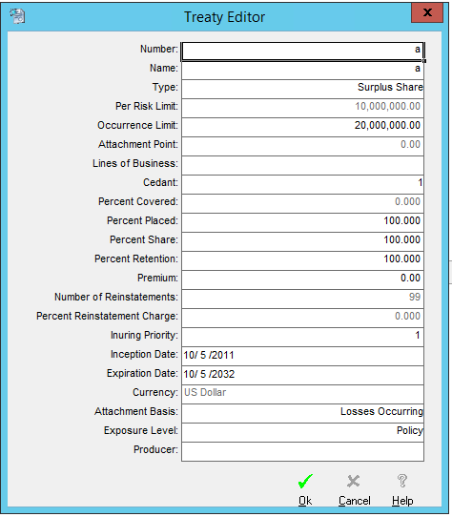
Surplus Share
02.
In the RMS interface you can set an occurrence limit and/or aggregate limit to the treaty along with
The Treaty Number NEEDS to be the same as the reinsurance ID in the import file otherwise the treaty will not work

Slide 15
03.
TIGERRISK PARTNERS Working Excess (Excess Per Risk)

Slide 16
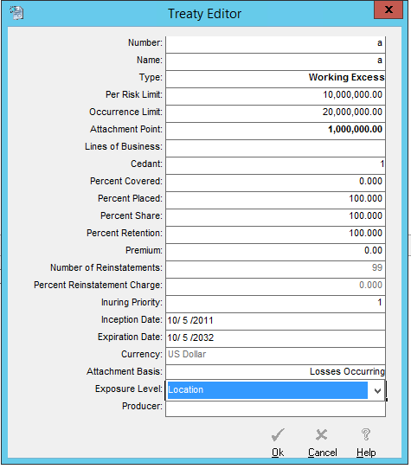
Working Excess (Excess Per Risk)
03.
XPR treaties are by far the most common type of reinsurance you will use within the model
The treaty ID can be any distinct ID (XPR 1, XPR 2 etc.) and the treaty can either apply at the account level, the policy level, or a location level.
You will always have a risk limit/retention for the treaty along with an occurrence limit and percent placed
You can filter which exposure applies to the treaty by indicating a Cedant and 1 or more Lines of Business

Slide 17
04.
TIGERRISK PARTNERS Quota Share

Slide 18
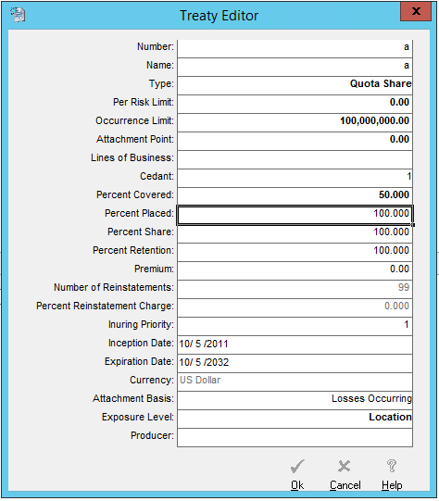
Quota Share
04.
Similar to working excess treaties you set a per risk and occurrence limit
The treaty can apply at the location, policy, or account level
You can filter which exposure applies to the treaty by indicating a Cedant and 1 or more Lines of Business
The main difference to Working Excess is that Quota Share will have a Percent Covered Less than 100%.

Slide 19
05.
TIGERRISK PARTNERS Catastrophe Layers

Slide 20
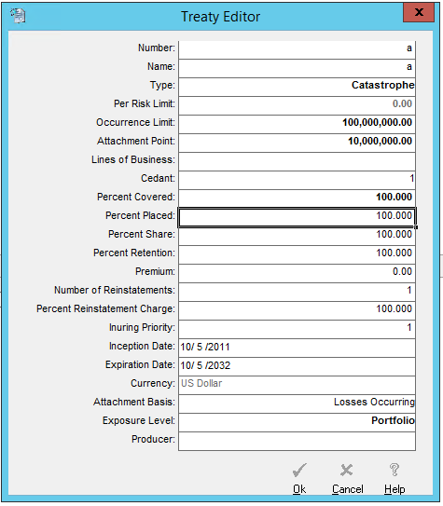
Catastrophe Treaties (and Corporate and Stop Loss)
05.
Typically, we model catastrophe layers in TigerEye, but some situations may call for you to use it within the model
These treaties will have an occurrence limit and attachment values, these apply at the portfolio level rather than the exposure level
For these layers you can also indicate the number of Reinstatements
Usually, cat layers have one or two reinstatements
For a Stop Loss treaty, the Occurrence Limit and Attachment point are actually Aggregate amounts.

Slide 21
06.
TIGERRISK PARTNERS Applying Treaties in RMS

Slide 22
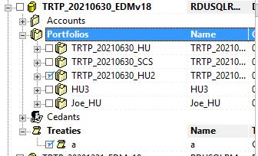
Applying Treaties in RMS
06.
In almost all cases you will be applying your treaties to your analyses as you submit them to the queue. When you are going through your normal process of submitting analyses in addition to checking the Portfolio and the DLM profile you will also need to check all Treaties that you want applied for the analysis.

Slide 23
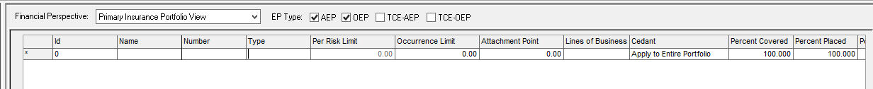
Applying Treaties In RMS After An Analysis
06.
For Catastrophe, Corporate and Stop Loss Treaties you also have the ability to model them against already completed analyses.
When looking at analysis results you can switch from “Key Losses” to “Treaties” and enter any treaty information that you want to apply.
Similar to how you would create a treaty, you will enter all of the treaty information in (limit, attachment point and percent covered).
When applying treaties this way you can only apply to the whole analysis, so if you need to apply the treaty to a subset, you will need a separate analysis.
This will permanently alter your analysis results (only Post Cat and Post Corporate Cat) so it is a good practice to make a copy of the analysis before applying.
2
3
4
1

Slide 24
07.
TIGERRISK PARTNERS Viewing Results

Slide 25
Viewing Results
07.
RMS provides several different Financial Perspectives for how to view modeled losses. Here are some of the ones applicable to Treaty modeling. The corresponding PERSPCODE can be used to view results through SQL as well.
Gross Loss (GR): The Insurer’s loss after policy deductibles, attachment point and limits are applied but before all RI.
Net Loss Pre Cat (RL): Gross Loss net of all Facultative, Surplus Share, Working Excess and Quota Share treaties.
Net Loss Post Cat (RP): Net Loss Pre Cat net of all Catastrophe treaties, but not Corporate or Stop Loss treaties.
Net Loss Post Corporate Cat (RC): The net loss after applying all treaties.
Facultative Reinsurance Loss (FA): The sum of facultative reinsurance losses for the location or policy.
Surplus Share Treaty Loss (SS): The sum of losses to any surplus share treaties that apply.
Quota Share Treaty Loss (QS): The sum of losses to all quota share treaties that apply.
Working Excess Treaty Loss (WX): The sum of losses to all working excess treaties that apply.
Treaty Underwriter View: Losses to each treaty included in the analysis excluding any reinsurer participation. Losses reflect Cedant Gross Loss and Net Loss Pre Cat.

Slide 26
08.
TIGERRISK PARTNERS Homework

Slide 27
Homework
08.
Apply the following reinsurance terms to your analyses
10% Quota Share
Working Excess treaty with the following terms
$1M xs $1M
$3M Occurrence Limit
Attaches at Policy Level
Catastrophe Reinsurance Layer
$10M xs $10M
90% placed
One Reinstatement

Slide 28


